Slide 1

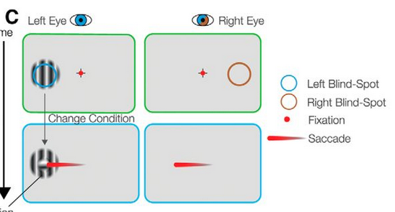
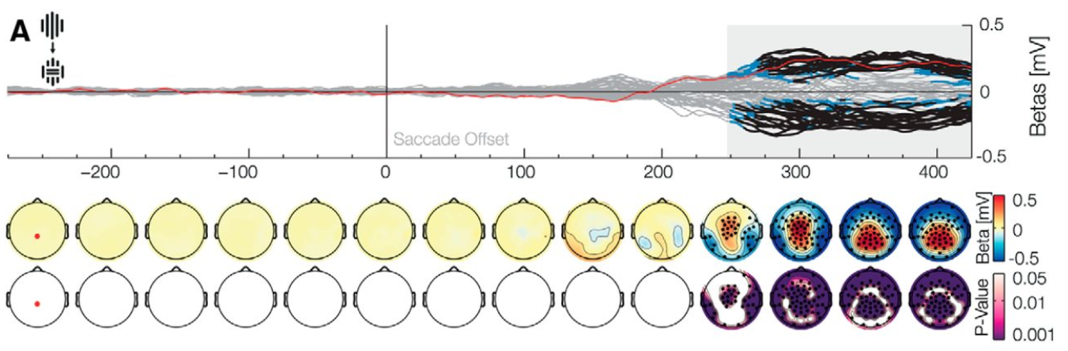
Milestone 1: Team „Strawbrainy“
Members: Nina Neuron, Basti Brain
Dataset: Ehinger et al. 2015, „Predictions of Visual Content across Eye Movements and Their Modulation by Inferred Information” – Doi: 10.1523/JNEUROSCI.5114-14.2015
1. Experimental procedure / Main idea
2. The main research question
Are we surprised differently, if our visual predictions were created by inferred (that is, internal) information?
3. Main finding to be replicated
4. Main type of analysis to be run
Regression analysis to look for a P300 effect

